Slide 1
Hackers Guide to Resisting the AI Apocalypse
Aaron Tello-Wharton | Majestic
@Majestic
majestic.com/to/resist-ai

Slide 2
Three things I want to cover
@Majestic #brightonSEO

Slide 3
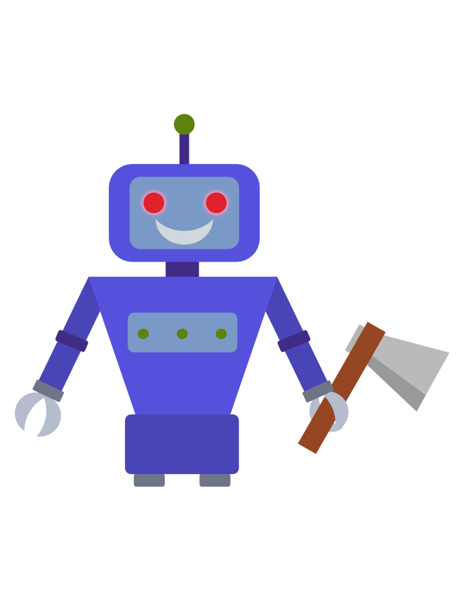
Three things I want to cover
@Majestic #brightonSEO

Slide 4
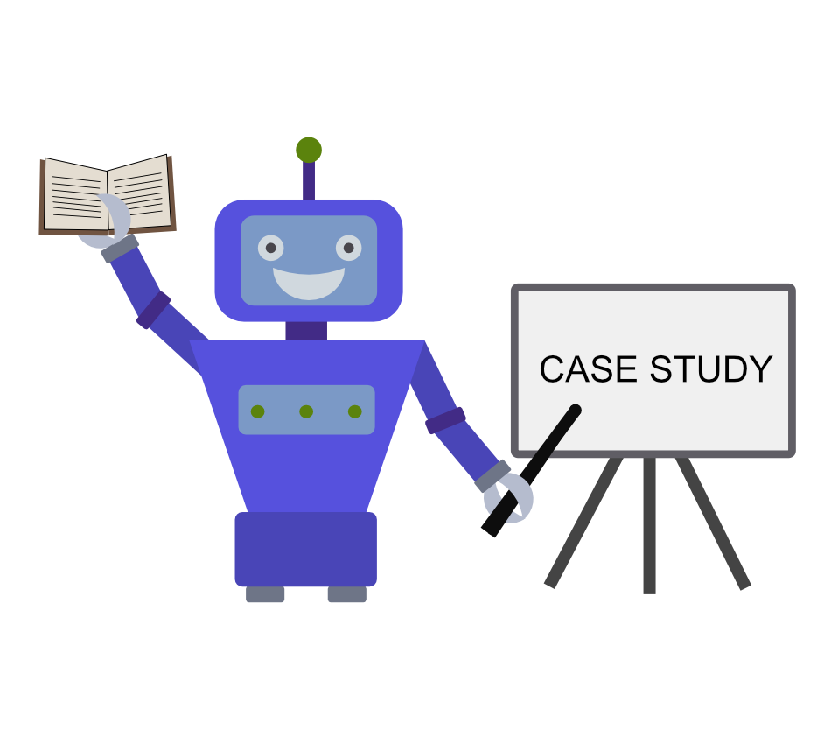
Three things I want to cover
@Majestic #brightonSEO

Slide 5
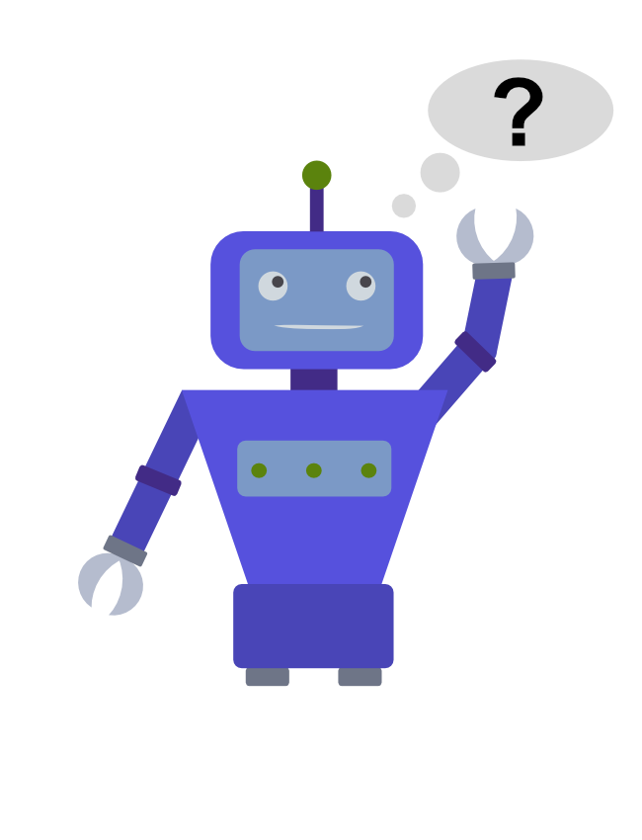
Three things I want to cover
@Majestic #brightonSEO

Slide 6
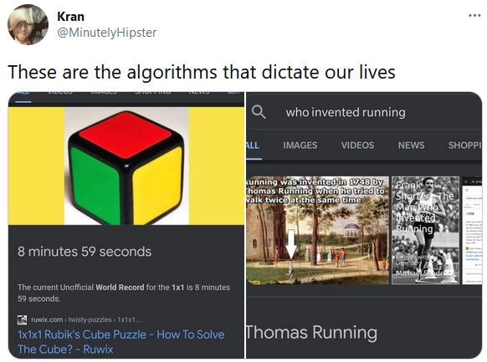
From Twitter user @MinutelyHipster
@Majestic #brightonSEO

Slide 7
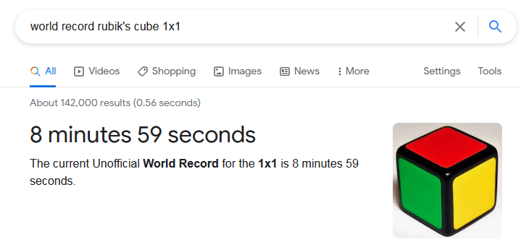
@Majestic #brightonSEO

Slide 8
@Majestic #brightonSEO

Slide 9
“In effect, Amazon’s system taught itself that male candidates were preferable. It penalized resumes that included the word ‘women’s,’ as in ‘women’s chess club captain.’”
Reuters (2018)
@Majestic #brightonSEO

Slide 10
“Twitter has apologised for a “racist” image cropping algorithm, after users discovered the feature was automatically focusing on white faces over black ones.”
The Guardian (2020)
@Majestic #brightonSEO

Slide 11
Okay…
AI can make some awful mistakes…
@Majestic #brightonSEO

Slide 12
Let’s do a (small) case study...

Slide 13
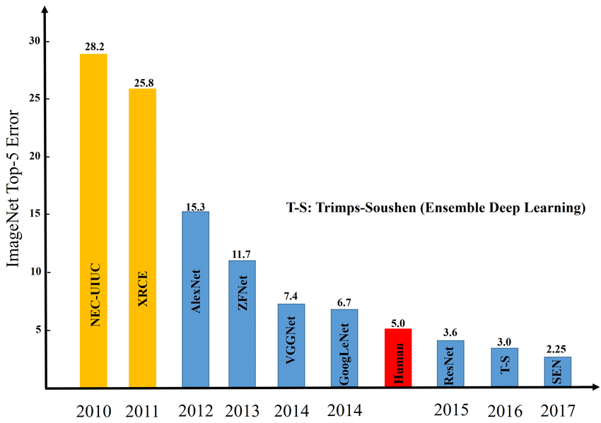
(Smaller is Better)
Inception-v3 (from Google)
@Majestic #brightonSEO

Slide 14
What is it good for?
Notes:
Will get a better resolution image

Slide 15
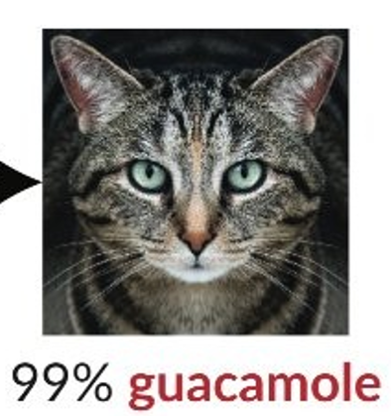
Notes:
Will get a better resolution image

Slide 16
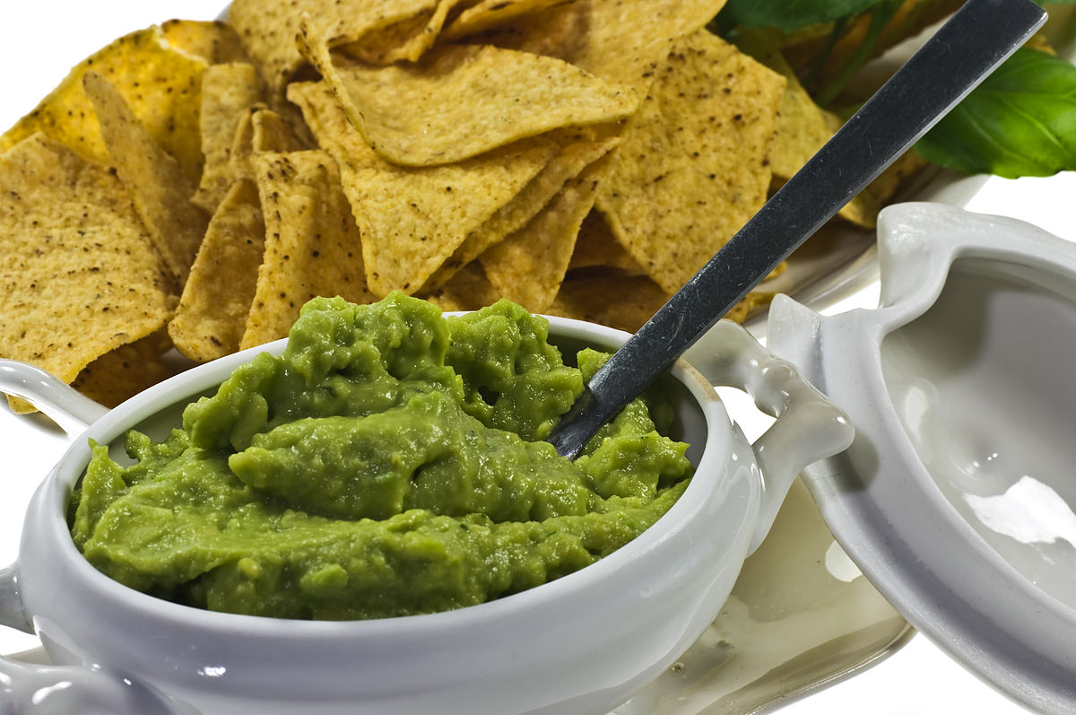
Source: https://commons.wikimedia.org/wiki/File:Guacamole_IMGP1303.jpg
Licence: https://creativecommons.org/licenses/by-sa/3.0/deed.en
Notes:
Will get a better resolution image

Slide 17
Notes:
Will get a better resolution image

Slide 18
Source: https://commons.wikimedia.org/wiki/File:Guacamole_IMGP1303.jpg
Licence: https://creativecommons.org/licenses/by-sa/3.0/deed.en
Notes:
Will get a better resolution image

Slide 19
Notes:
Will get a better resolution image

Slide 20
Source: https://commons.wikimedia.org/wiki/File:Guacamole_IMGP1303.jpg
Licence: https://creativecommons.org/licenses/by-sa/3.0/deed.en
Notes:
Will get a better resolution image

Slide 21
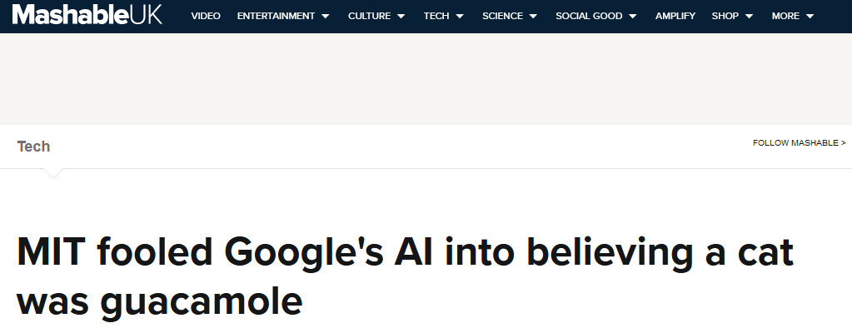
Mashable 2017
@Majestic #brightonSEO

Slide 22
The Inception-v3 image recognition AI thinks this is a picture of guacamole!
Notes:
Will get a better resolution image

Slide 23
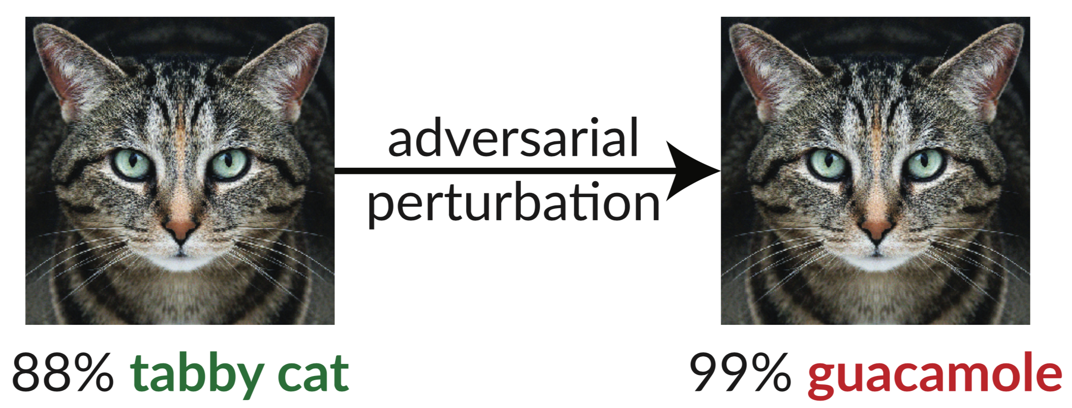
from https://github.com/anishathalye/obfuscated-gradients
@Majestic #brightonSEO

Slide 24
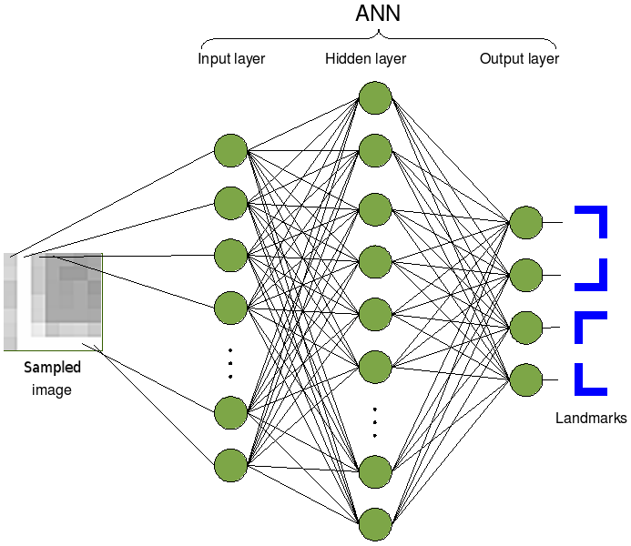
A bit about neural networks...
Cyberbotics Ltd., CC BY-SA 3.0 <https://creativecommons.org/licenses/by-sa/3.0>, via Wikimedia Commons
@Majestic #brightonSEO

Slide 25
A bit about neural networks...
Cat
Dog
Fish
Guacamole
Cyberbotics Ltd., CC BY-SA 3.0 <https://creativecommons.org/licenses/by-sa/3.0>, via Wikimedia Commons
@Majestic #brightonSEO

Slide 26
How does a neural network get good?
CALCULUS!

Slide 27
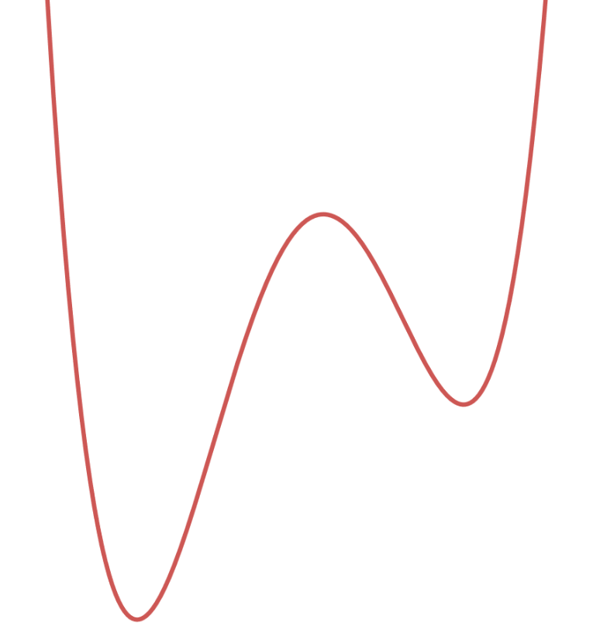
Let’s scrap the formulas...
E(x)
E(x)
x
@Majestic #brightonSEO

Slide 28
You are here (or rather, your AI is)
E(x)
.
E(x)
x
@Majestic #brightonSEO

Slide 29
The bottom of the graph is here
E(x)
.
E(x)
x
@Majestic #brightonSEO

Slide 30
Let’s move down the curve…
E(x)
.
E(x)
x
@Majestic #brightonSEO

Slide 31
We end up here… with less error!
E(x)
.
E(x)
x
@Majestic #brightonSEO

Slide 32
And again...
E(x)
.
E(x)
x
@Majestic #brightonSEO

Slide 33
Even better!
E(x)
E(x)
.
x
@Majestic #brightonSEO

Slide 34
Cat
Dog
Fish
Guacamole
Cyberbotics Ltd., CC BY-SA 3.0 <https://creativecommons.org/licenses/by-sa/3.0>, via Wikimedia Commons
@Majestic #brightonSEO

Slide 35
Okay cool, but how do we trick the AI?
The following is based on: Intriguing properties of neural networks (2013) Szegedy et al https://arxiv.org/abs/1312.6199

Slide 36
Rather than minimising the error function...
Can we maximise it?

Slide 37
(spoiler) yes!

Slide 38
Cat
Dog
Fish
Guacamole
Cyberbotics Ltd., CC BY-SA 3.0 <https://creativecommons.org/licenses/by-sa/3.0>, via Wikimedia Commons
@Majestic #brightonSEO

Slide 39
Alter an image’s pixels step by step…
E(x)
E(x)
.
x
@Majestic #brightonSEO
Notes:
https://thenounproject.com/term/underwear/68158/

Slide 40
Alter an image’s pixels step by step…
E(x)
E(x)
.
x
@Majestic #brightonSEO

Slide 41
Alter an image’s pixels step by step…
E(x)
E(x)
.
x
@Majestic #brightonSEO

Slide 42
.
Off the chart error!
E(x)
E(x)
x
@Majestic #brightonSEO

Slide 43
Does this work in practice?

Slide 44
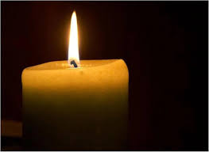
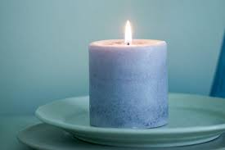
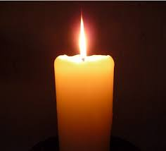
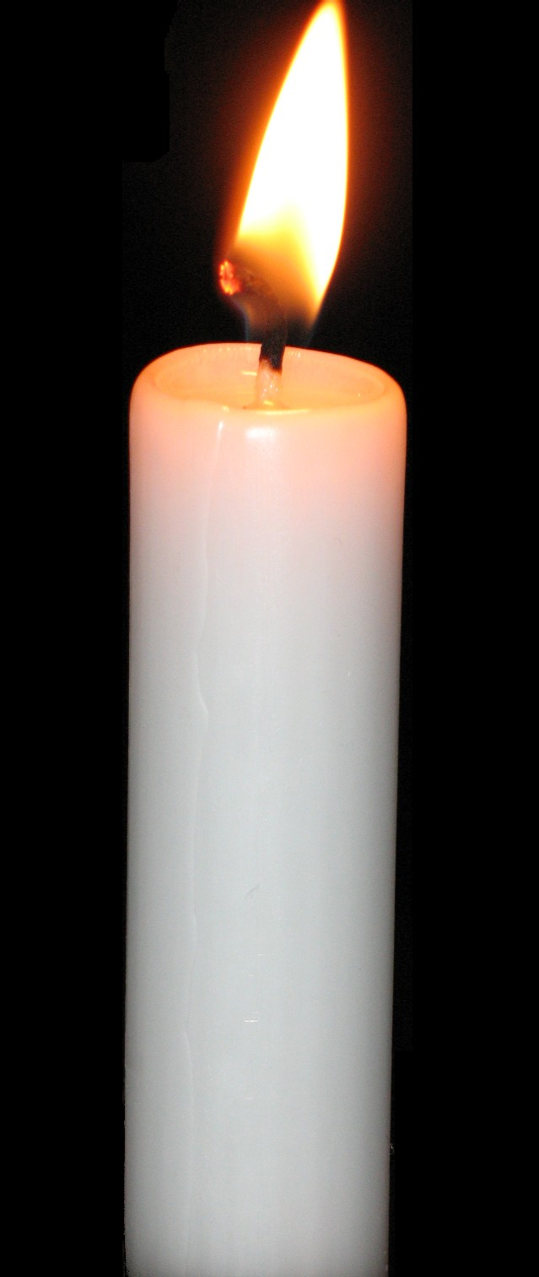
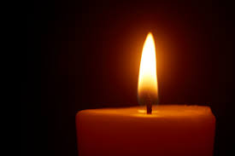
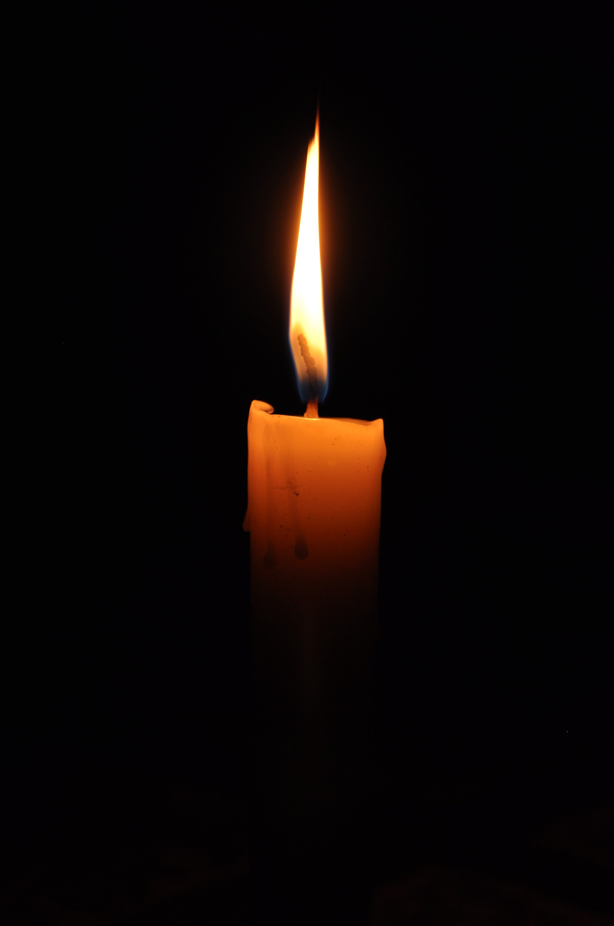
Does Inception know these are candles?
@Majestic #brightonSEO

Slide 45
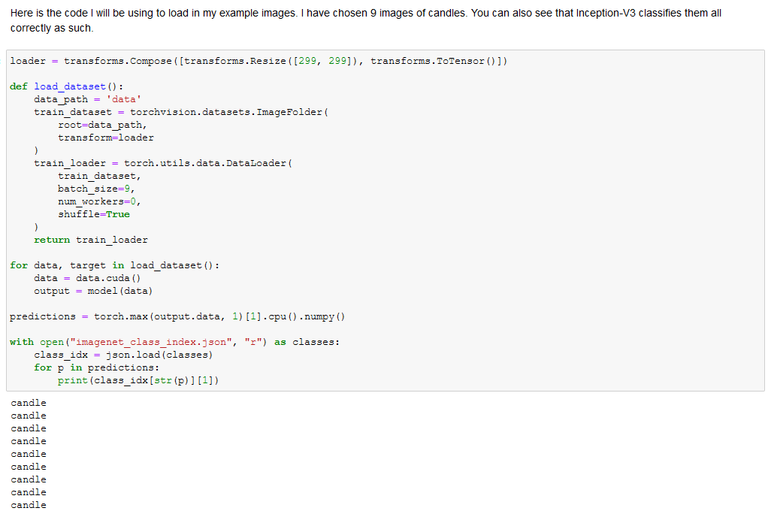
@Majestic #brightonSEO
Notes:
I think we should split this into 2-3 slides

Slide 46
And now for the deceit...

Slide 47
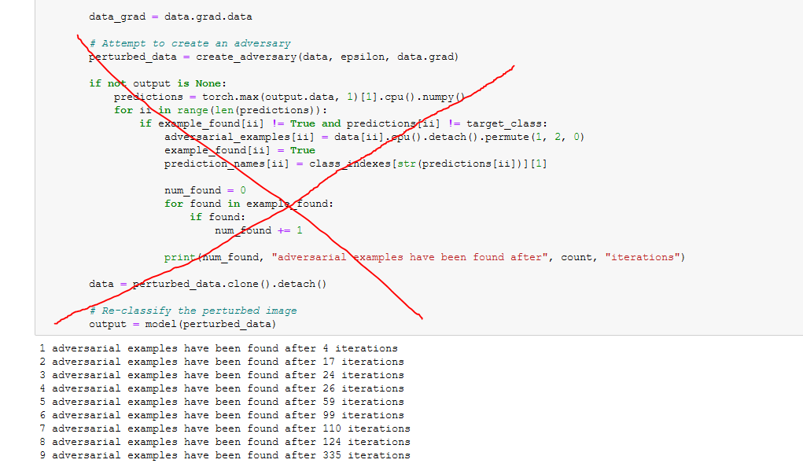
@Majestic #brightonSEO

Slide 48
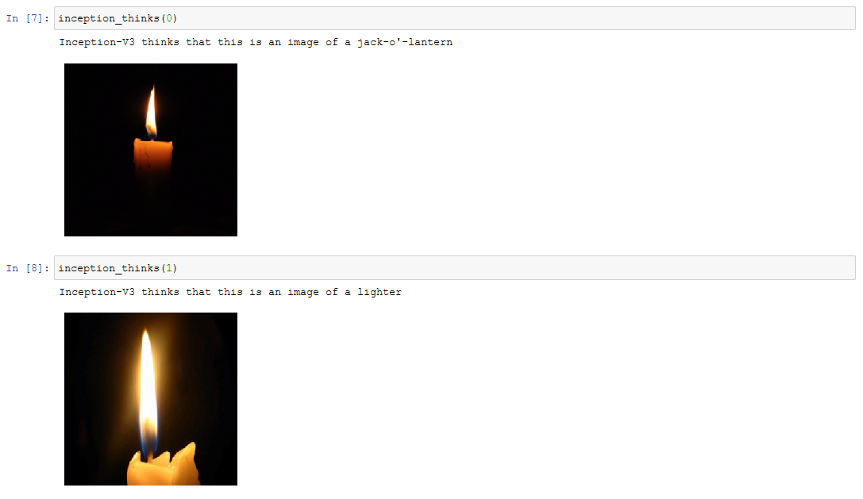
@Majestic #brightonSEO
Notes:
I think we should split this into 2-3 slides

Slide 49
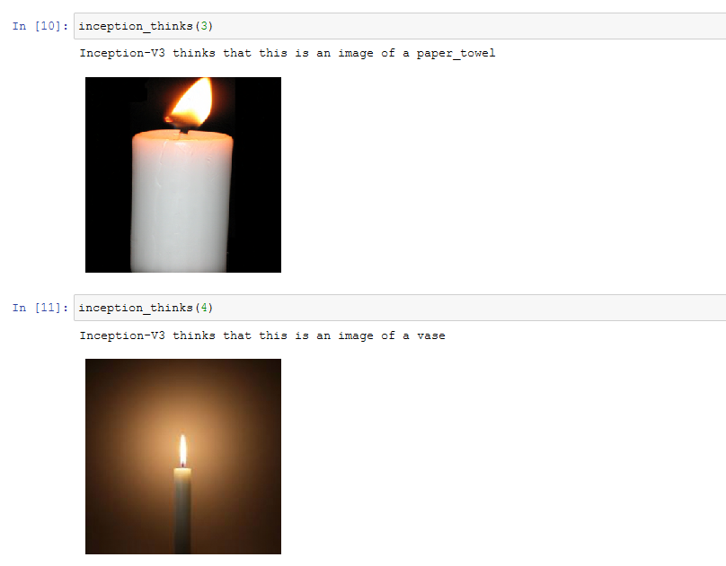
@Majestic #brightonSEO
Notes:
I think we should split this into 2-3 slides

Slide 50
This isn’t the cat-guacamole you promised me Aaron!
from https://github.com/anishathalye/obfuscated-gradients
@Majestic #brightonSEO

Slide 51
What we want is a targeted adversary

Slide 52
Manipulate the images…
To minimise the error function for the wrong classification

Slide 53
Cat
Dog
Fish
Guacamole
Cyberbotics Ltd., CC BY-SA 3.0 <https://creativecommons.org/licenses/by-sa/3.0>, via Wikimedia Commons
@Majestic #brightonSEO

Slide 54
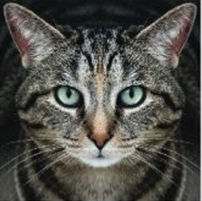
Cat
❌
Dog
❌
❌
Fish
✔️
Guacamole
Cyberbotics Ltd., CC BY-SA 3.0 <https://creativecommons.org/licenses/by-sa/3.0>, via Wikimedia Commons
@Majestic #brightonSEO

Slide 55
Not very guacamole
E(x)
.
E(x)
x
@Majestic #brightonSEO

Slide 56
Make it more like guacamole
E(x)
.
E(x)
x
@Majestic #brightonSEO

Slide 57
We end up here… with less error!
E(x)
.
E(x)
x
@Majestic #brightonSEO

Slide 58
Make it even more like guacamole
E(x)
.
E(x)
x
@Majestic #brightonSEO

Slide 59
Getting warmer...
E(x)
E(x)
.
x
@Majestic #brightonSEO

Slide 60
MAXIMUM GUACAMOLIFICATION!
E(x)
E(x)
.
x
@Majestic #brightonSEO

Slide 61
Your cat has become guacamole
E(x)
E(x)
.
x
@Majestic #brightonSEO
Notes:
We could add the 99% guacamole cat picture again to pop up in the end

Slide 62
Managing expectations

Slide 63
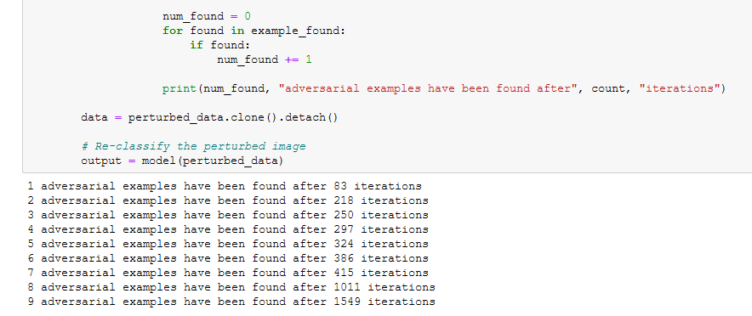
@Majestic #brightonSEO

Slide 64
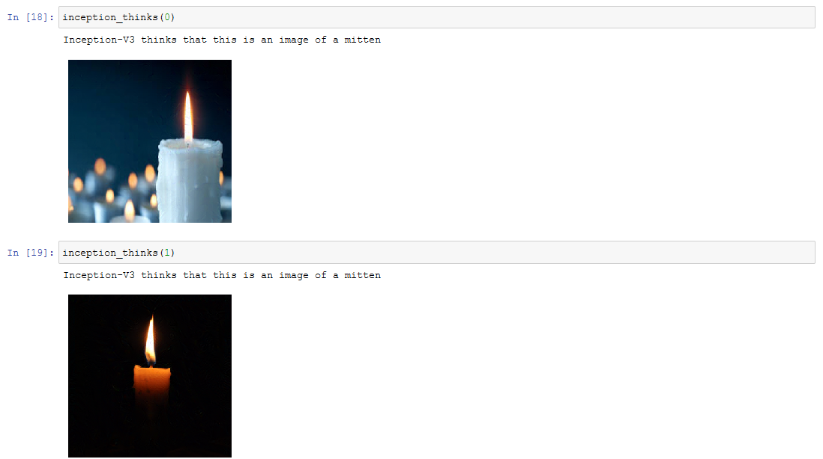
@Majestic #brightonSEO
Notes:
I think we should split this into 2-3 slides

Slide 65
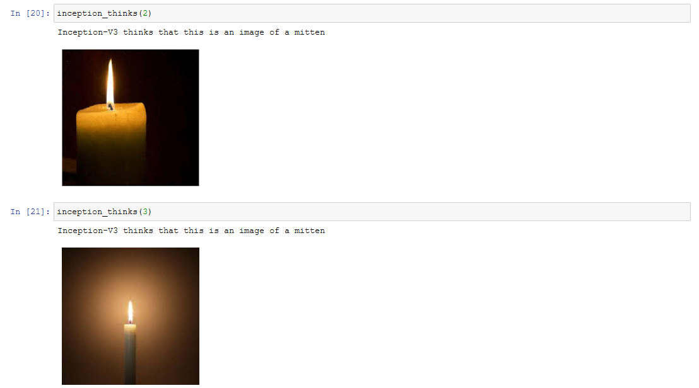
@Majestic #brightonSEO
Notes:
I think we should split this into 2-3 slides

Slide 66
Key Takeaways

Slide 67
We can easily make images that AI cannot classify

Slide 68
We can easily make an AI misclassify an image as a specific target

Slide 69
Artificial 👏 Intelligence 👏 is 👏 fallible 👏

Slide 70
Inception-v3
@Majestic #brightonSEO

Slide 71
Fun side note

Slide 72
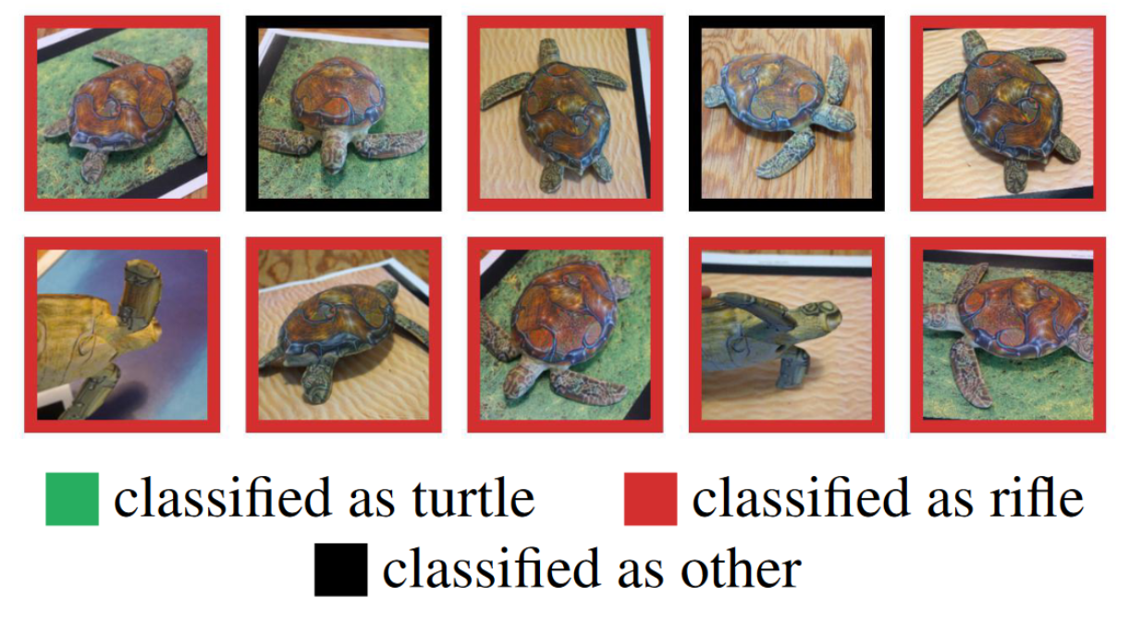
Synthesizing Robust Adversarial Examples (2018) By Anish Athalye, Logan Engstrom, Andrew Ilyas, Kevin Kwok https://arxiv.org/abs/1707.07397v3
@Majestic #brightonSEO

Slide 73
Wait, so what about the AI apocalypse?

Slide 74
I lied! It’s a bait and switch!

Slide 75
AI won’t ruin our lives. But programmers might!
Most people do not have control over how AI works, but AI does have control over important parts of our lives.
@Majestic #brightonSEO

Slide 76
I think AI and Machine Learning are really fun to work with
Notes:
Need to think of an ending

Slide 77
For more info visit: https://majestic.com/to/resist-ai
Notes:
Need to think of an ending

